Slide 1
LECTURE 2: Process Models
Course Supervisor: Syeda Nazia Ashraf
Software Engineering: A Practitioner’s Approach, 7/e
by Roger S. Pressman

Slide 2
What / who / why is Process Models?
What: Go through a series of predictable steps--- a road map that helps you create a timely, high-quality results.
Who: Software engineers and their managers, clients also. People adapt the process to their needs and follow it.
Why: Provides stability, control, and organization to an activity that can if left uncontrolled, become quite chaotic. However, modern software engineering approaches must be agile and demand ONLY those activities, controls and work products that are appropriate.
What Work products: Programs, documents, and data
What are the steps: The process you adopt depends on the software that you are building. One process might be good for aircraft avionic system, while an entirely different process would be used for website creation.
How to ensure right: A number of software process assessment mechanisms, that enable us to determine the maturity of the software process. However, the quality, timeliness and long-term viability of the software are the best indicators of the efficacy of the process you use.

Slide 3
A Generic Process Model
In software process, each framework activity is populated by a set of software engineering actions.
Each software engineering action is defined by a task set that identifies the work tasks that are to be completed, the work products that will be produced, the quality assurance points that will be required, and the milestones that will be used to indicate progress.

Slide 4
A Generic Process Model
As we discussed before(chapter : 1), a generic process framework for software engineering defines five framework activities communication, planning, modeling, construction, and deployment.
In addition, a set of umbrella activities- project tracking and control, risk management, quality assurance, configuration management, technical reviews, and others are applied throughout the process.
Next question is: how the framework activities and the actions and tasks that occur within each activity are organized with respect to sequence and time? See the process flow for answer.

Slide 5
Process Flow
process flow—describes how the framework activities and the actions and tasks that occur within each framework activity are organized with respect to sequence and time.
A linear process flow executes each of the five framework activities in sequence, beginning with communication and culminating with deployment (Figure 2.2a).
An iterative process flow repeats one or more of the activities before proceeding to the next (Figure 2.2b).
An evolutionary process flow executes the activities in a “circular” manner. Each circuit through the five activities leads to a more complete version of the software (Figure 2.2c).
A parallel process flow (Figure 2.2d) executes one or more activities in parallel with other activities (e.g., modeling for one aspect of the software might be executed in parallel with construction of another aspect of the software).

Slide 6
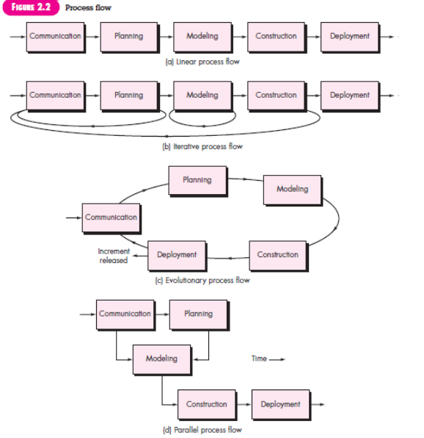
Process Flow

Slide 7
Identifying a Task Set
Each Software Engineering action can be represented by a number of different tasks sets- each a collection of software engineering work tasks, related work products, quality assurance points, and project milestones.
A task set defines the actual work to be done to accomplish the objectives of a software engineering action.
A list of the task to be accomplished
A list of the work products to be produced
A list of the quality assurance filters to be applied

Slide 8
Example-Identifying a Task Set
For example, a small software project requested by one person with simple requirements, the communication activity might encompass little more than a phone all with the stakeholder. Therefore, the only necessary action is phone conversation, the work tasks of this action are:
1. Make contact with stakeholder via telephone.
2. Discuss requirements and take notes.
3. Organize notes into a brief written statement of requirements.
4. E-mail to stakeholder for review and approval.

Slide 9
Example of a Task Set for Elicitation
The task sets for Requirements gathering action for a simple project may include:
1. Make a list of stakeholders for the project.
2. Invite all stakeholders to an informal meeting.
3. Ask each stakeholder to make a list of features and functions required.
4. Discuss requirements and build a final list.
5. Prioritize requirements.
6. Note areas of uncertainty.

Slide 10
Example of a Task Set for Elicitation
The task sets for Requirements gathering (Elicitation) action for a big project may include:
1. Make a list of stakeholders for the project.
2. Interview each stakeholders separately to determine overall wants and needs.
3. Build a preliminary list of functions and features based on stakeholder input.
4. Schedule a series of facilitated application specification meetings.
5. Conduct meetings.
6. Produce informal user scenarios as part of each meeting.
7. Refine user scenarios based on stakeholder feedback.
8. Build a revised list of stakeholder requirements.
9. Use quality function deployment techniques to prioritize requirements.
10. Package requirements so that they can be delivered incrementally.
11. Note constraints and restrictions that will be placed on the system.
12. Discuss methods for validating the system.
Both of these task sets do the same work with different depth and formality. Choose the task sets that achieve the goal and still maintain quality and agility.

Slide 11
Example of a Task Set
for Elicitation

Slide 12
Process Patterns
A process pattern
describes a process-related problem that is encountered during software engineering work,
identifies the environment in which the problem has been encountered, and
suggests one or more proven solutions to the problem.
Stated in more general terms, a process pattern provides you with a template [Amb98]—a consistent method for describing problem solutions within the context of the software process. ( defined at different levels of abstraction)
1. Problems and solutions associated with a complete process model (e.g. prototyping).
2. Problems and solutions associated with a framework activity (e.g. planning) or
3. an action with a framework activity (e.g. project estimating).

Slide 13
Process Pattern Types
Stage patterns—defines a problem associated with a framework activity for the process. An example of a stage pattern might be EstablishingCommunication. This pattern would incorporate the task pattern RequirementsGathering and others.
Task patterns—defines a problem associated with a software engineering action or work task and relevant to successful software engineering practice. (e.g., RequirementsGathering is a task pattern).
Phase patterns—define the sequence of framework activities that occur with the process, even when the overall flow of activities is iterative in nature. An example of a phase pattern might be SpiralModel or Prototyping.

Slide 15
Process Assessment and Improvement
A number of different approaches to software process assessment and improvement have been proposed over the past few decades:
Standard CMMI Assessment Method for Process Improvement (SCAMPI) — provides a five step process assessment model that incorporates five phases: initiating, diagnosing, establishing, acting and learning.
CMM-Based Appraisal for Internal Process Improvement (CBA IPI)—provides a diagnostic technique for assessing the relative maturity of a software organization; uses the SEI CMM as the basis for the assessment [Dun01]
SPICE—The SPICE (ISO/IEC15504) standard defines a set of requirements for software process assessment. The intent of the standard is to assist organizations in developing an objective evaluation of the efficacy of any defined software process. [ISO08]
ISO 9001:2000 for Software—a generic standard that applies to any organization that wants to improve the overall quality of the products, systems, or services that it provides. Therefore, the standard is directly applicable to software organizations and companies. [Ant06]

Slide 16
Prescriptive Models
Prescriptive process models advocate an orderly approach to software engineering
That leads to a few questions …
If prescriptive process models strive for structure and order, are they inappropriate for a software world that thrives on change?
Yet, if we reject traditional process models (and the order they imply) and replace them with something less structured, do we make it impossible to achieve coordination and coherence in software work?

Slide 17
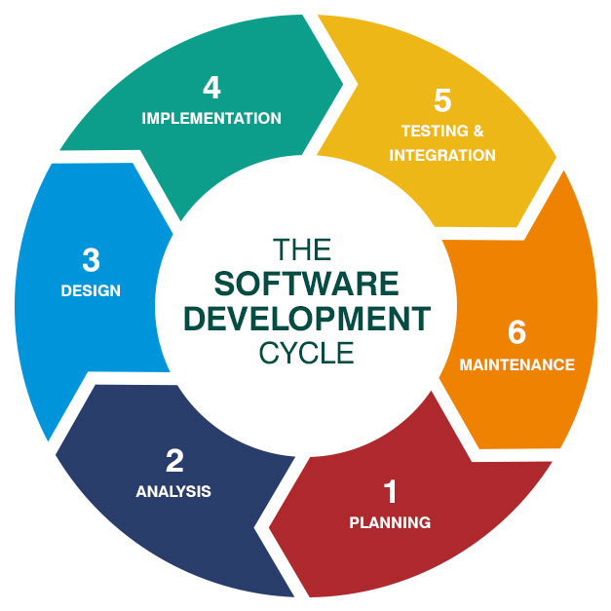
SOFTWARE PROCESS MODELS
To solve actual problems in an industry setting, a software engineer or a team of engineers must incorporate a development strategy that encompasses the process, methods, and tools layers.
This strategy is often referred to as a process model or a software engineering paradigm. A process model for software engineering is chosen based on the nature of the project and application, the methods and tools to be used, and the controls and deliverables that are required.
Some methodologies are sometimes known as software development life cycle (SDLC) methodologies, though this term could also be used more generally to refer to any methodology.

Slide 18
THE WATERFALL MODEL (LINEAR SEQUENTIAL)
The waterfall model, sometimes called the classic life cycle, suggests a systematic, sequential approach to software development that begins with customer specification of requirements and progress through planning, modeling, construction and deployment, culminating in ongoing support of the completed software.
It is the oldest paradigm for SE. When requirements are well defined and reasonably stable, it leads to a linear fashion.
(problems: 1. rarely linear, iteration needed. 2. hard to state all requirements explicitly. Blocking state. 3. code will not be released until very late.)

Slide 19
phases in sequential Waterfall model
The phases in sequential Waterfall model are:
1. Requirement Gathering and analysis: All possible requirements of the system to be developed are captured in this phase and documented in a requirement specification document.
2. System Design: The requirement specifications from first phase are studied in this phase and the system design is prepared. This system design helps in specifying hardware and system requirements and helps in defining the overall system architecture.
3. Implementation: With inputs from the system design, the system is first developed in small programs called units, which are integrated in the next phase. Each unit is developed and tested for its functionality, which is referred to as Unit Testing.
4. Integration and Testing: All the units developed in the implementation phase are integrated into a system after testing of each unit. Post integration the entire system is tested for any faults and failures.
5. Deployment of system: Once the functional and non-functional testing is done; the product is deployed in the customer environment or released into the market.
6. Maintenance: There are some issues which come up in the client environment. To fix those issues, patches are released. Also to enhance the product some better versions are released. Maintenance is done to deliver these changes in the customer environment.
All these phases are cascaded to each other in which progress is seen as flowing steadily downwards (like a waterfall) through the phases. The next phase is started only after the defined set of goals are achieved for previous phase and it is signed off, so the name "Waterfall Model". In this model, phases do not overlap.

Slide 20
Waterfall Model Applications
Every software developed is different and requires a suitable SDLC approach to be followed based on the internal and external factors. Some situations where the use of Waterfall model is most appropriate are:
Requirements are very well documented, clear and fixed.
Product definition is stable.
Technology is understood and is not dynamic.
There are no ambiguous requirements.
Ample resources with required expertise are available to support the product.
The project is short.

Slide 21
Advantages of Waterfall Model
The advantages of waterfall development are that it allows for departmentalization and control. A schedule can be set with deadlines for each stage of development and a product can proceed through the development process model phases one by one.
Development moves from concept, through design, implementation, testing, installation, troubleshooting, and ends up at operation and maintenance. Each phase of development proceeds in strict order.
Some of the major advantages of the Waterfall Model are as follows:
Simple and easy to understand and use
Easy to manage due to the rigidity of the model. Each phase has specific deliverables and a review process.
Phases are processed and completed one at a time.
Works well for smaller projects where requirements are very well understood.
Clearly defined stages.
Well understood milestones.
Easy to arrange tasks.
Process and results are well documented.

Slide 22
Disadvantages of Waterfall Model
The disadvantage of waterfall development is that it does not allow much reflection or revision. Once an application is in the testing stage, it is very difficult to go back and change something that was not well-documented or thought upon in the concept stage.
The major disadvantages of the Waterfall Model are as follows
No working software is produced until late during the life cycle.
High amounts of risk and uncertainty.
Not a good model for complex and object-oriented projects.
Poor model for long and ongoing projects.
Not suitable for the projects where requirements are at a moderate to high risk of changing. So, risk and uncertainty is high with this process model.
It is difficult to measure progress within stages.
Cannot accommodate changing requirements.
Adjusting scope during the life cycle can end a project.
Integration is done as a "big-bang” at the very end, which doesn't allow identifying any technological or business bottleneck or challenges early.

Slide 23
DRAWBACKS OF WATERFALL MODEL
The Waterfall model is the oldest and the most widely used paradigm for software engineering. It has also following Drawbacks:
1. Real projects rarely follow the sequential flow that the model proposes. Although the linear model can accommodate iteration, it does so indirectly. As a result, changes can cause confusion as the project team proceeds.
2. It is often difficult for the customer to state all requirements explicitly. The linear sequential model requires this and has difficulty accommodating the natural uncertainty that exists at the beginning of many projects.
3. The customer must have patience. A working version of the program(s) will not be available until late in the project time-span. A major blunder, if undetected until the working program is reviewed, can be disastrous.
4. The linear nature of the classic life cycle leads to “blocking states” in which some project team members must wait for other members of the team to complete dependent tasks.

Slide 24
V-Model
A variation of waterfall model depicts the relationship of quality assurance actions to the actions associated with communication, modeling and early code construction activates(Figure 2.4)
As a software team moves down the left side of the V, basic problem requirements are refined into progressively more detailed and technical representations of the problem and its solution.
Once code is generated, the team moves up the right side of the V, performing a series of tests (Quality Assurance actions) that validate each of the models created as the team moved down the left side.
The V-model provides a way of visualizing how verification and validation actions are applied to earlier engineering work.
Today, software work is fast-paced and subject to a never-ending stream of changes (to features, functions, and information content). The waterfall model is often inappropriate for such work. However, it can serve as a useful process model in situations where requirements are fixed and work is to proceed to completion in a linear manner.

Slide 26
Incremental Process Model
The incremental model delivers a series of releases, called increments that provide progressively more functionality for the customer as each increment is delivered. The incremental model combines elements of linear and parallel process flows.
“Incremental Model is a process of software development where requirements are broken down into multiple standalone modules of software development cycle. Incremental development is done in steps from analysis design, implementation, testing/verification, maintenance.”
Incremental development is particularly useful when staffing is unavailable for a complete implementation by the business deadline that has been established for the project.
Increments can be planned to manage technical risks.

Slide 27
Incremental Model
When an incremental model is used, the first increment is often a core product. That is, basic requirements are addressed but many supplementary features (some known, others unknown) remain undelivered.
The core product is used by the customer (or undergoes detailed evaluation). As a result of use and/or evaluation, a plan is developed for the next increment.
The plan addresses the modification of the core product to better meet the needs of the customer and the delivery of additional features and functionality.
This process is repeated following the delivery of each increment, until the complete product is produced.

Slide 28
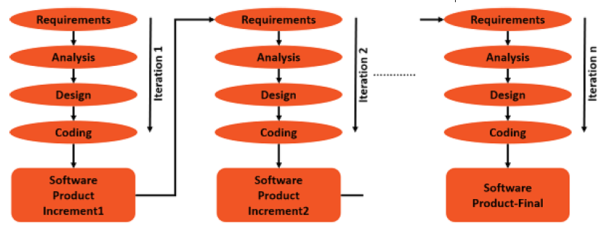

Slide 30
Advantages of Incremental Process Model
The advantages or strengths of Iterative Incremental model are:
You can develop prioritized requirements first.
Initial product delivery is faster.
Customers gets important functionality early.
Lowers initial delivery cost.
Each release is a product increment, so that the customer will have a working product at hand all the time.
Customer can provide feedback to each product increment, thus avoiding surprises at the end of development.
Requirements changes can be easily accommodated.

Slide 31
Disadvantages of Incremental Process Model
The disadvantages of the Iterative Incremental model are:
Requires effective planning of iterations.
Requires efficient design to ensure inclusion of the required functionality and provision for changes later.
Requires early definition of a complete and fully functional system to allow the definition of increments.
Well-defined module interfaces are required, as some are developed long before others are developed.
Total cost of the complete system is not lower.

Slide 32
When to Use Incremental Process Model?
Iterative Incremental model can be used when:
Most of the requirements are known up-front but are expected to evolve over time.
The requirements are prioritized.
There is a need to get the basic functionality delivered fast.
A project has lengthy development schedules.
A project has new technology.
The domain is new to the team.

Slide 33
Incremental development benefits
The cost of accommodating changing customer requirements is reduced.
The amount of analysis and documentation that has to be redone is much less than is required with the waterfall model.
It is easier to get customer feedback on the development work that has been done.
Customers can comment on demonstrations of the software and see how much has been implemented.
More rapid delivery and deployment of useful software to the customer is possible.
Customers are able to use and gain value from the software earlier than is possible with a waterfall process.

Slide 34
Incremental development problems
The process is not visible.
Managers need regular deliverables to measure progress. If systems are developed quickly, it is not cost-effective to produce documents that reflect every version of the system.
System structure tends to degrade as new increments are added.
Unless time and money is spent on refactoring to improve the software, regular change tends to corrupt its structure. Incorporating further software changes becomes increasingly difficult and costly.

Slide 35
Evolutionary Process Models
Evolutionary models are iterative.
They are characterized in a manner that enables you to develop increasingly more complete versions of the software.
Three types are introduced, namely Prototyping, Spiral model and Concurrent development model

Slide 36
1. Prototyping Model
The prototype can serve as “the first system”. Although some prototypes are built as “throwaways”, others are evolutionary in the sense that the prototype slowly evolves into the actual system.
When to use: Customer defines a set of general objectives but does not identify detailed requirements for functions and features. Or Developer may be unsure of the efficiency of an algorithm, the form that human computer interaction should take.
What step: Begins with communication by meeting with stakeholders to define the objective, identify whatever requirements are known, outline areas where further definition is mandatory. A quick plan for prototyping and modeling (quick design) occur. Quick design focuses on a representation of those aspects the software that will be visible to end users (interface and output). Design leads to the construction of a prototype which will be deployed and evaluated. Stakeholder’s comments will be used to refine requirements.
Both stakeholders and software engineers like the prototyping paradigm. Users get a feel for the actual system, and developers get to build something immediately. However, engineers may make compromises in order to get a prototype working quickly. The less than- ideal choice may be adopted forever after you get used to it.

Slide 37
Prototype is defined as first or preliminary form using which other forms are copied or derived. Prototype model is a set of general objectives for software. It does not identify the requirements like detailed input, output. It is software working model of limited functionality. In this model, working programs are quickly produced.
The different phases of Prototyping model are:
1. Communication: In this phase, developer and customer meet and discuss the overall objectives of the software.
2. Quick design: Quick design is implemented when are known. It includes only the important requirements aspects like input and output format of the software. It focuses on those aspects which are visible to the user rather than the detailed plan. It helps to construct a prototype.
3. Modeling quick design: This phase gives the clear idea about the development of software because the software is now built. It allows the developer to better understand the exact requirements.
4. Construction of prototype: The prototype is evaluated by the customer itself.
5. Deployment, delivery, feedback: If the user is not satisfied with current prototype then it refines according to the requirements of the user. The process of refining the prototype is repeated until all the requirements of users are met. When the users are satisfied with the developed prototype then the system is developed on the basis of final prototype.

Slide 39
Benefits of prototyping
Improved system usability.
A closer match to users’ real needs.
Improved design quality.
Improved maintainability.
Reduced development effort.

Slide 40
DRAWBACKS
Prototyping can also be problematic for the following reasons:
1. The customer does not understand clearly the product he is looking as it is a prototype. He assume this is the product, whereas the actual product is developed after prototyping.
2. The developer often makes implementation compromises in order to get a prototype working quickly.

Slide 41
Advantages of Prototyping Model
Prototype model need not know the detailed input, output, processes, adaptability of operating system and full machine interaction.
In the development process of this model users are actively involved.
The development process is the best platform to understand the system by the user.
Errors are detected much earlier.
Gives quick user feedback for better solutions.
It identifies the missing functionality easily. It also identifies the confusing or difficult functions.

Slide 42
Disadvantages of Prototyping Model:
The client involvement is more and it is not always considered by the developer.
It is a slow process because it takes more time for development.
Many changes can disturb the rhythm of the development team.
It is a thrown away prototype when the users are confused with it.

Slide 44
The Spiral Model (Software Development For Critical Projects)
It couples the iterative nature of prototyping with the controlled and systematic aspects of the waterfall model and is a risk-driven process model generator that is used to guide multi-stakeholder concurrent engineering of software intensive systems.
Two main distinguishing features: one is cyclic approach for incrementally growing a system’s degree of definition and implementation while decreasing its degree of risk. The other is a set of 3 anchor point milestones(Life Cycle Objectives (LCO), Life Cycle Architecture (LCA), Initial Operational Capability (IOC)) for ensuring stakeholder commitment to feasible and mutually satisfactory system solutions. These milestones serve as intermediate checkpoints to keep the project moving full steam ahead in the right direction.
Unlike other process models that end when software is delivered, the spiral model can be adapted to apply throughout the life of the computer software.
Define Artifacts Concurrently (AKA “Plan everything, then re-plan those plans, then plan some more.”). A series of evolutionary releases are delivered. During the early iterations, the release might be a model or prototype. During later iterations, increasingly more complete version of the engineered system are produced.
The first circuit in the clockwise direction might result in the product specification; subsequent passes around the spiral might be used to develop a prototype and then progressively more sophisticated versions of the software. Each pass results in adjustments to the project plan. Cost and schedule are adjusted based on feedback. Also, the number of iterations will be adjusted by project manager.
Good to develop large-scale system as software evolves as the process progresses and risk should be understood and properly reacted to. Prototyping is used to reduce risk. However, it may be difficult to convince customers that it is controllable as it demands considerable risk assessment expertise.

Slide 45
The Spiral Model (Software Development For Critical Projects)
Spiral model is a risk driven process model. It is used for generating the software projects.
In spiral model, an alternate solution is provided if the risk is found in the risk analysis, then alternate solutions are suggested and implemented.
It is a combination of prototype and sequential model or waterfall model.
In one iteration all activities are done, for large projects the output is small.
The framework activities of the spiral model are as shown in the following figure.

Slide 47
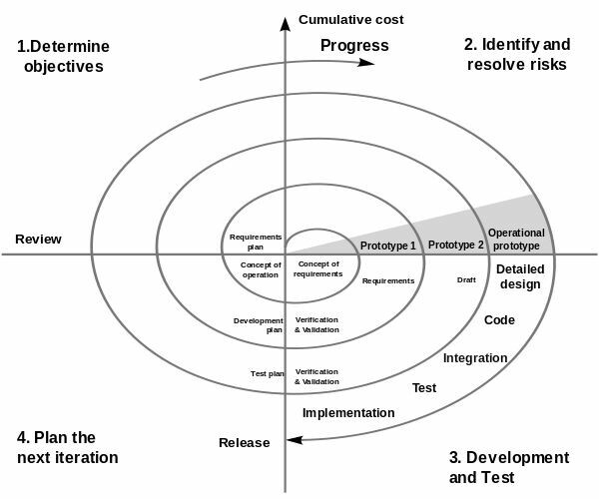

Slide 48
Spiral model sectors
Objective setting
Specific objectives for the phase are identified.
Risk assessment and reduction
Risks are assessed and activities put in place to reduce the key risks.
Development and validation
A development model for the system is chosen which can be any of the generic models.
Planning
The project is reviewed and the next phase of the spiral is planned.

Slide 49
Spiral model usage
Spiral model has been very influential in helping people think about iteration in software processes and introducing the risk-driven approach to development.
In practice, however, the model is rarely used as published for practical software development.

Slide 50
Advantages of Spiral Model
It reduces high amount of risk.
It is good for large and critical projects.
It gives strong approval and documentation control.
In spiral model, the software is produced early in the life cycle process.

Slide 51
Disadvantages
It can be costly to develop a software model.
It is not used for small projects.

Slide 52
Three Concerns on Evolutionary Processes
First concern is that prototyping poses a problem to project planning because of the uncertain number of cycles required to construct the product.
Second, it does not establish the maximum speed of the evolution. If the evolution occur too fast, without a period of relaxation, it is certain that the process will fall into chaos. On the other hand if the speed is too slow then productivity could be affected.
Third, software processes should be focused on flexibility and extensibility rather than on high quality. We should prioritize the speed of the development over zero defects. Extending the development in order to reach high quality could result in a late delivery of the product when the opportunity niche has disappeared.

Slide 53
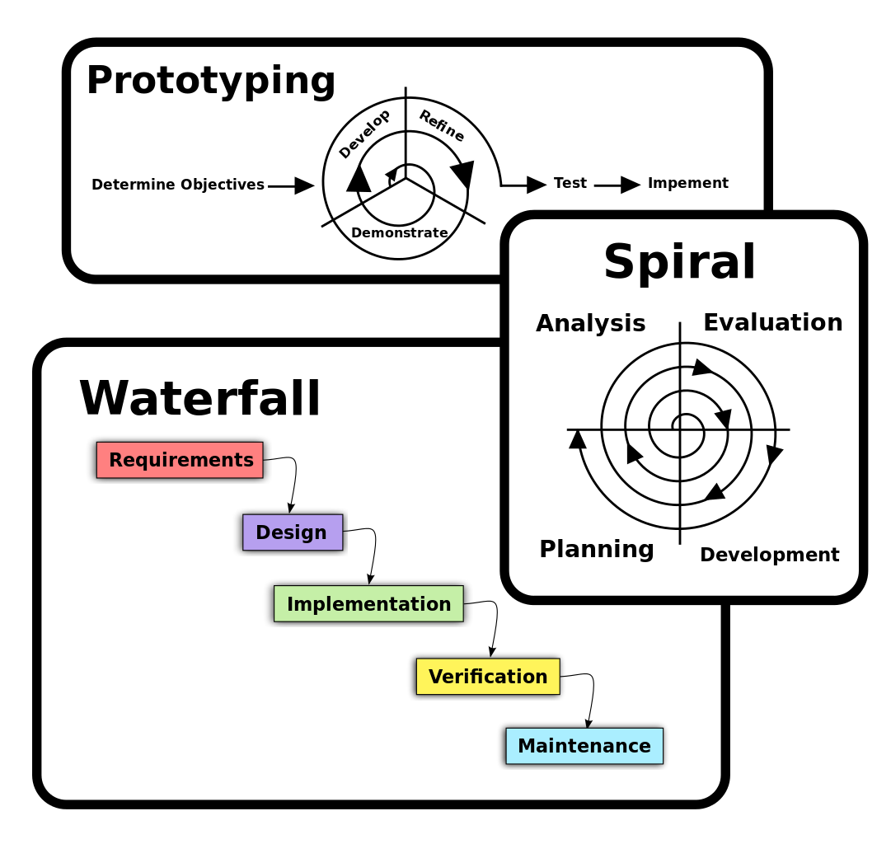

Slide 55
Specialized Process Models
Component based development—The process to apply when reuse is a development objective (like spiral model)
Formal methods—emphasizes the mathematical specification of requirements (easy to discover and eliminate ambiguity, incompleteness and inconsistency)
AOSD (Aspect-oriented software development)—provides a process and methodological approach for defining, specifying, designing, and constructing aspects.
Rational Unified Process (RUP)—a “use-case driven, architecture-centric, iterative and incremental” software process closely aligned with the Unified Modeling Language (UML) to model and develop object-oriented system iteratively and incrementally.

Slide 56
Comparison of different life-cycle models
The classical waterfall model can be considered as the basic model and all other life cycle models as embellishments of this model. However, the classical waterfall model cannot be used in practical development projects, since this model supports no mechanism to handle the errors committed during any of the phases.
This problem is overcome in the iterative waterfall model. The iterative waterfall model is probably the most widely used software development model evolved so far. This model is simple to understand and use. However this model is suitable only for well-understood problems; it is not suitable for very large projects and for projects that are subject to many risks.
The prototyping model is suitable for projects for which either the user requirements or the underlying technical aspects are not well understood. This model is especially popular for development of the user-interface part of the projects.
The evolutionary approach is suitable for large problems which can be decomposed into a set of modules for incremental development and delivery. This model is also widely used for object oriented development projects. Of course, this model can only be used if the incremental delivery of the system is acceptable to the customer. The spiral model is called a meta model since it encompasses all other life cycle models. Risk handling is inherently built into this model.

Slide 57
Comparison of different life-cycle models
The spiral model is suitable for development of technically challenging software products that are prone to several kinds of risks. However, this model is much more complex than the other models – this is probably a factor deterring its use in ordinary projects.
The different software life cycle models can be compared from the viewpoint of the customer. Initially, customer confidence in the development team is usually high irrespective of the development model followed. During the lengthy development process, customer confidence normally drops off, as no working product is immediately visible. Developers answer customer queries using technical slang, and delays are announced. This gives rise to customer resentment.
On the other hand, an evolutionary approach lets the customer experiment with a working product much earlier than the monolithic approaches. Another important advantage of the incremental model is that it reduces the customer’s trauma of getting used to an entirely new system. The gradual introduction of the product via incremental phases provides time to the customer to adjust to the new product. Also, from the customer’s financial viewpoint, incremental development does not require a large upfront capital outlay. The customer can order the incremental versions as and when he can afford them.

Slide 58
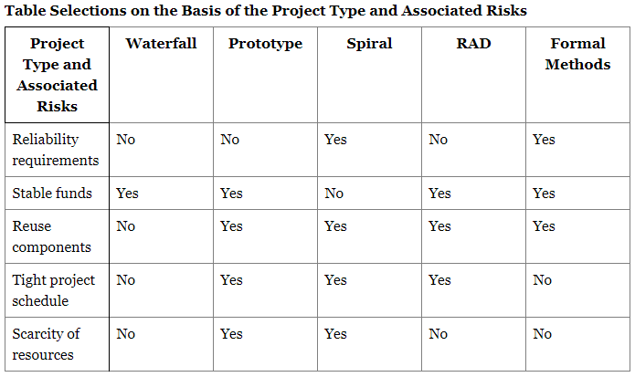

Slide 59
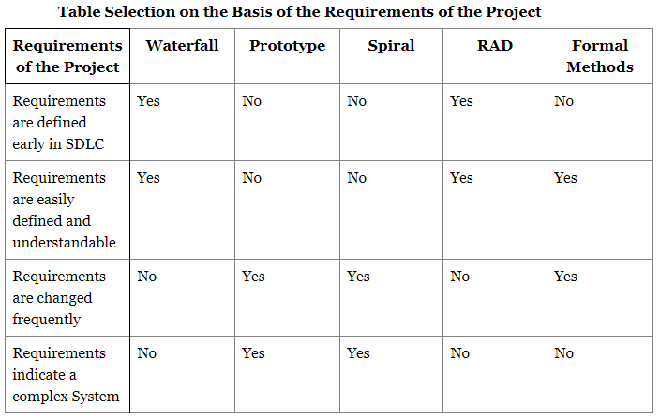

Slide 60
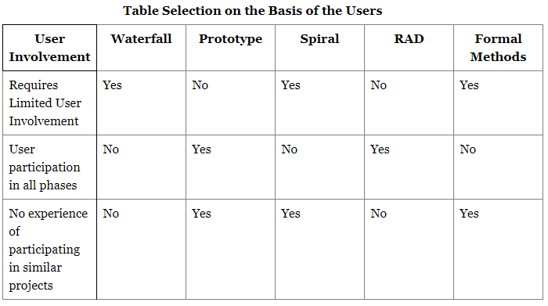

Slide 61
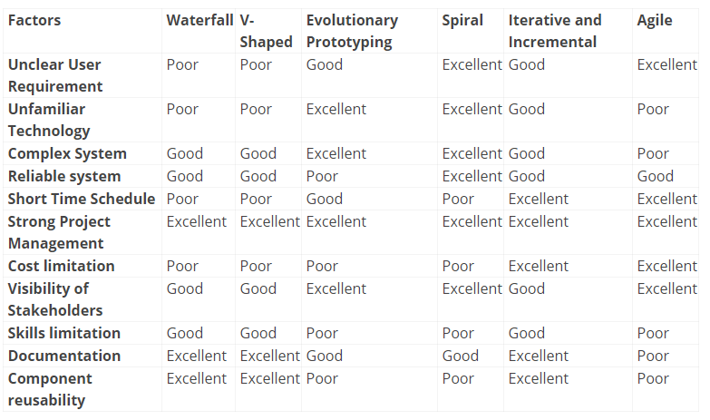

Slide 62
Reading Assignment
Concurrent development model
RAD Model
Iterative Model

